Slide 1
The Role of Post Forms and End of Life Planning
Tennessee End of Life Partnership
Nov 15th, 2012

Slide 2
Palliative Care Defined
Palliative care is specialized medical care for people with serious illnesses. This type of care is focused on providing patients with relief from the symptoms, pain, and stress of a serious illness—whatever the diagnosis.
The goal is to improve quality of life for both the patient and the family. Palliative care is provided by a team of doctors, nurses, and other specialists who work with a patient's other doctors to provide an extra layer of support. Palliative care is appropriate at any age and at any stage in a serious illness, and can be provided together with curative treatment.
Palliative care is specialized medical care for people with serious illnesses. This type of care is focused on providing patients with relief from the symptoms, pain, and stress of a serious illness—whatever the diagnosis.
The goal is to improve quality of life for both the patient and the family. Palliative care is provided by a team of doctors, nurses, and other specialists who work with a patient's other doctors to provide an extra layer of support. Palliative care is appropriate at any age and at any stage in a serious illness, and can be provided together with curative treatment.

Slide 3
Curative and Palliative Models
Curative
Primary Goal is cure
Object of Treatment is the disease
Symptoms treated primarily as clues to diagnosis
Primary Value placed on measurable data such as labs and tests
This model tends to devalue data that is subjective, immeasurable or unverifiable.
Therapy indicated if it eradicates disease or slows progression.
Patient’s body differentiated from mind.
Patient viewed as collection of parts so there is little need to get to know the whole person.
Death is the ultimate failure
Palliative
Primary Goal Relieving Suffering
Object of Treatment patient and family
Distressing Symptoms entities themselves
Subjective and measurable data valued
This model values patient experience as an illness
Therapy indicated if it controls symptoms for relieves suffering
Patient is viewed as complex being with physical emotional social and spiritual dimensions
Treatment Congruent with values and beliefs and concerns of patient and family
Enabling a patient to live fully and comfortably until he or she dies is a success
Unipac 1: Characteristics of Curative vs Palliative Care Models
Page 8. 2003

Slide 4
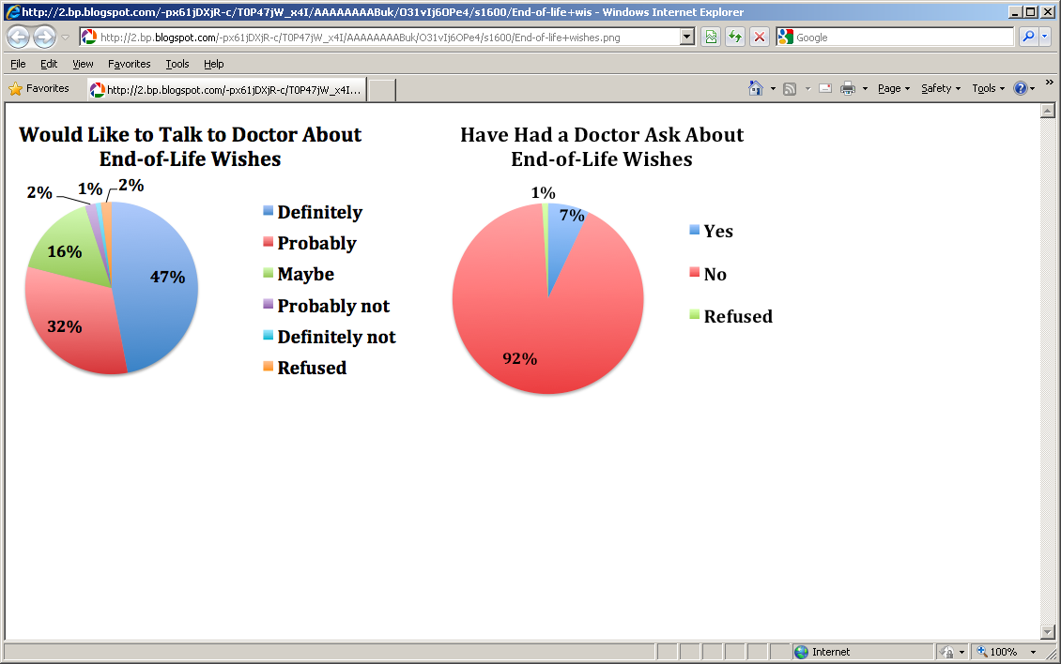
California Healthcare Foundation Survey 2012
70% -90% of patient’s say they would prefer to die at home (about 30% do) 66% say
they would prefer to die a natural peaceful death. Only 7% desire
all invasive therapeutic options deployed.

Slide 5
CAPC Survey of Attitudes For Patients with Serious Illness 800 patient’s surveyed Released June 28th 2011 Available at CAPC.org
Biggest concerns: Cost, Control, Communication, Choice, Cure?
Physicians not providing all treatment options- 55%
Doctors not sharing information with each other-55%
Doctors not choosing best option for seriously ill- 54%
Patient and family leave physician office not knowing what they are supposed to do when they get home-51%
Patient lacks control over treatment options- 51%
Doctor doesn’t spend enough time talking and listening with patient and family 50%

Slide 6
End of Life Discussions Subjects terminal cancer patient 4.4 month life expectancy
123 of 332 (37%) patients with terminal illness had end of life discussions
“Have you and your doctor discussed any particular wishes you have about the care you would receive if you were dying?”
These patients elected less aggressive care with fewer ICU admits 4.1% vs 12.4%, fewer ventilation episodes 1.6 vs 11%,
More aggressive care was associated with poorer quality of life for the patient and higher risk of major depressive disorder for bereaved care givers. (PTSD)
AA Wright, B Zhang A.Ray et al, Associations Between
End of Life Discussions Patient Mental Health, Medical Care Near Death
And Caregiver Bereavement Adjustment. JAMA 1665-1673. Oct 8, 2008

Slide 7
Advanced Directive and Cost
One quarter of all Medicare spending in in the final year of life.
In high-spending regions, adjusted spending on patients with a treatment-limiting advance directive was $33,933, whereas adjusted spending for patients without an advance directive was $39,518, a difference of $5,585. The team prospectively studied data for 3,302 Medicare beneficiaries who died between 1998 and 2007
Nicholas LH, Langa KM, Iwashyna J, Weir DR. Regional Variation in the association Between
Advance Directives and End of Life Medicare Expenditures. JAMA Oct 5 2011 Vol.
306 #13 1447- 53

Slide 8
More Confusion
Study of 80 surrogates of critically ill patients
If told there was a low risk of death, surrogates could accurately reflect this back
If told there was a high risk of death (<5% survival surrogates retained an unrealistically estimate of survival of between 25-95% chance of surviving.
Zier L, White D, Surrogate Decision Makers’ Interpretation of Prognostic Information. Annals of Internal Medicine March 6th 2012 360-66

Slide 9
Prognosis: The Chance to Plan
Medical Literature Dx 37%, Tx 33%, Px 4%
Unofficial Physician Norms: (The opportunity to look stupid)
Don’t make a prognosis
If you have a prognosis, keep it to yourself unless asked
Don’t be specific,
Don’t be extreme
Be optimistic
Doctors Err 2-5x duration to the optimistic side
Prognosis- lack of activity is death foretold
Death Foretold by Nicholas Christakis

Slide 10
Eastern Co-operative Oncology Group ECOG (1982)
ECOG PERFORMANCE STATUS*
Grade ECOG
0. Fully active, able to carry on all pre-disease performance without
restriction
Restricted in physically strenuous activity but ambulatory and able to carry out work of a light or sedentary nature, e.g., light house work, office work
Ambulatory and capable of all self care but unable to carry out any work activities. Up and about more than 50% of waking hours
Capable of only limited self care, confined to bed or chair more than 50% of waking hours. (estimated survival < 6 months)
Completely disabled. Cannot carry on any self care. Totally confined to bed or chair (estimated survival < 3 months)
Dead
Most clinical trials require ECOG status of 0-1

Slide 11
So What Happens to the Elderly (Survey 4158 Seniors)
Non-Hospice Patients
Hospice patients
Elderly patients avg. age 83
75% visit ER in final 6 months (40% more than once)
>50% visit ER final month
Of those in ER, 75% admitted
39% admitted to ICU
68% admitted died in hospital
Hospice Patients
Less than 10% seen in ER
Vast majority die at home
Smith AK, McCarthy E, Weber E et al; Half Of Older Americans Seen In Emergency Department In Last Month Of Life; Most Admitted To Hospital, And Many Die There. Health Affairs. June 2012 31:61277-1285

Slide 12
Dying Badly Don’t Sing “Rocky Top”
Failing to plan, is planning to fail.
60% of oncologists prefer not to discuss end of life care until ALL other options are expended* so patient is often rushed into hospice in the final two weeks (or two days) with little opportunity to prepare. (20% of hospice patients die in under 48h)
Most common bad deaths include: terminal delirium, uncontrolled pain, endless nausea, unresolved family conflict
Preparation and anticipation are key to dealing with these.
General In-Patient (GIP)admission is appropriate for uncontrolled symptoms.
“Excessive” communication with family
*Mitka, M. Cancer Experts Recommend Introducing Palliative Care at time of Diagnosis
JAMA V 307 No. 12 (March 28th 2012) 121-1242

